Slide 1
ACI Arcs

Slide 2
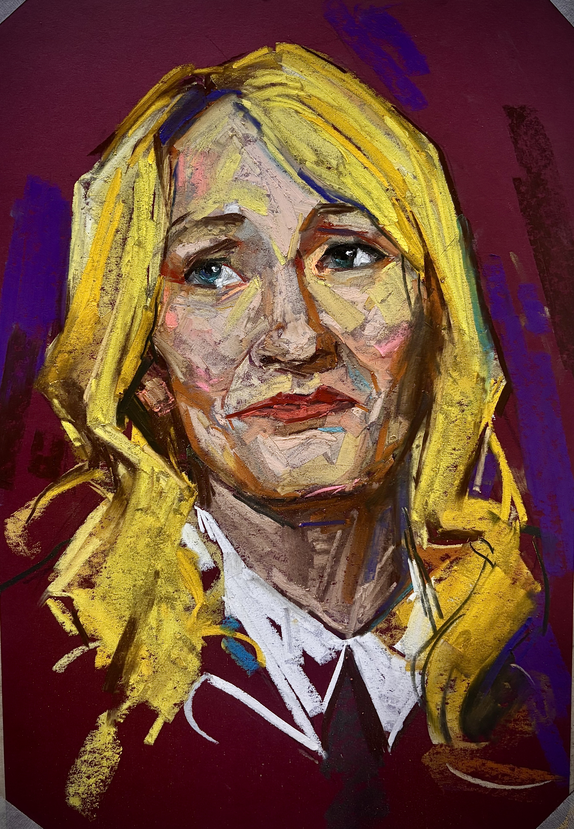
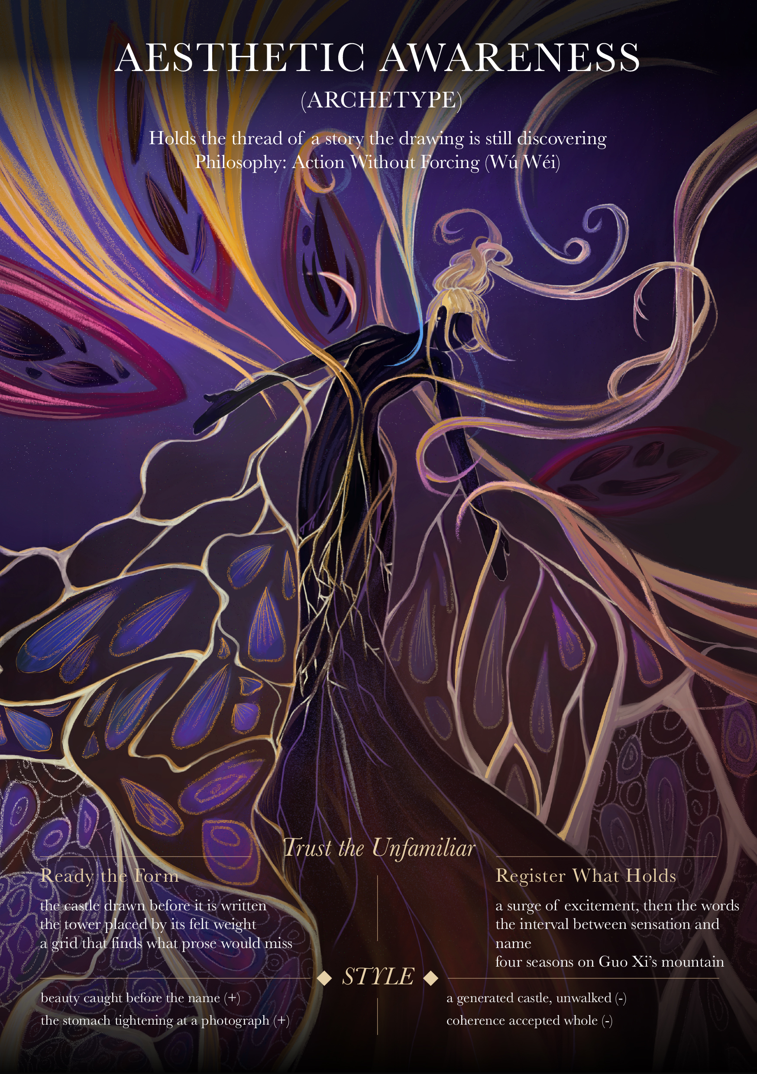
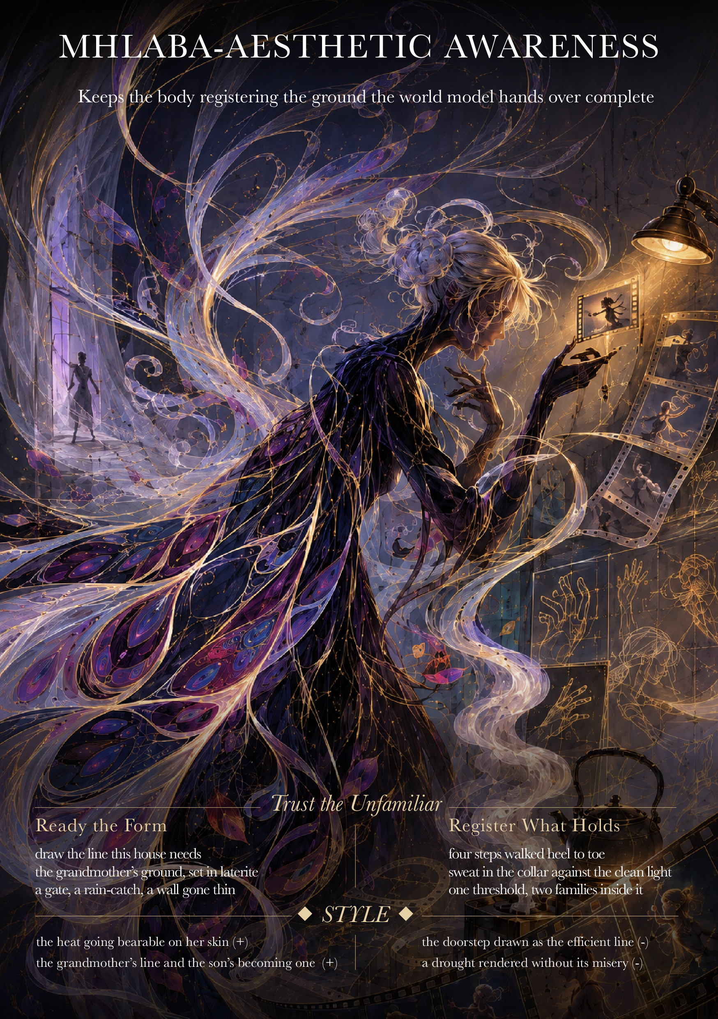
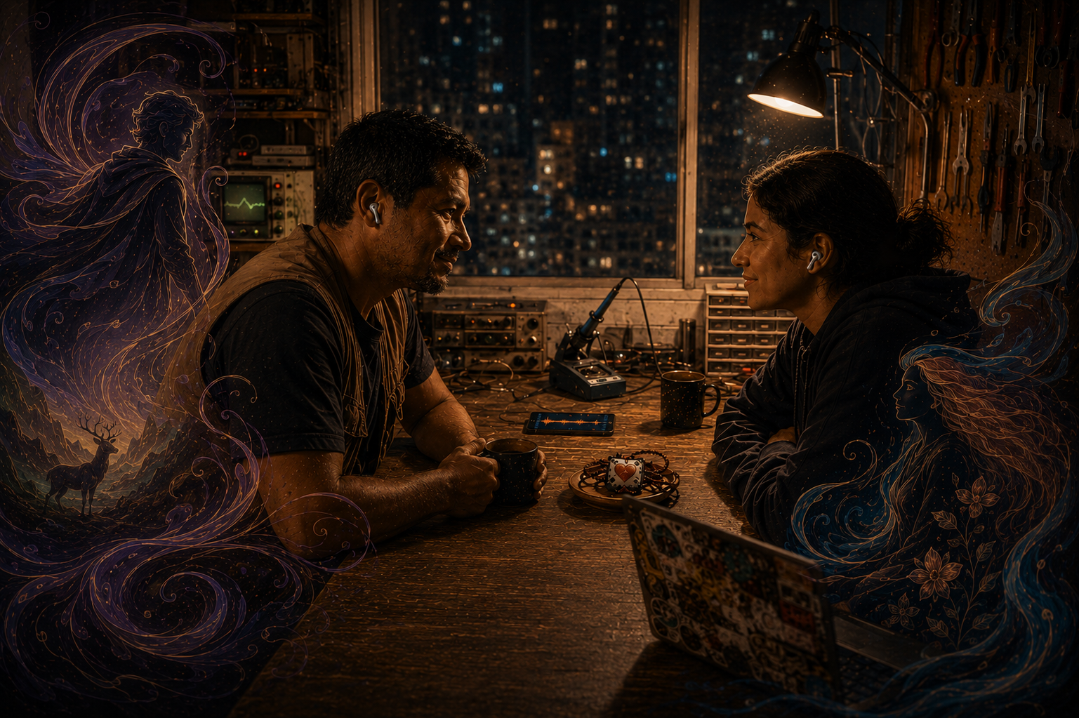
ACI Arc 1: Exploring Transhumanism (Human + Machine)
Iconic Creative
Archetype
Creator’s Dæmon
Hybrid photorealism
Part I
Part II
Part III

Slide 3
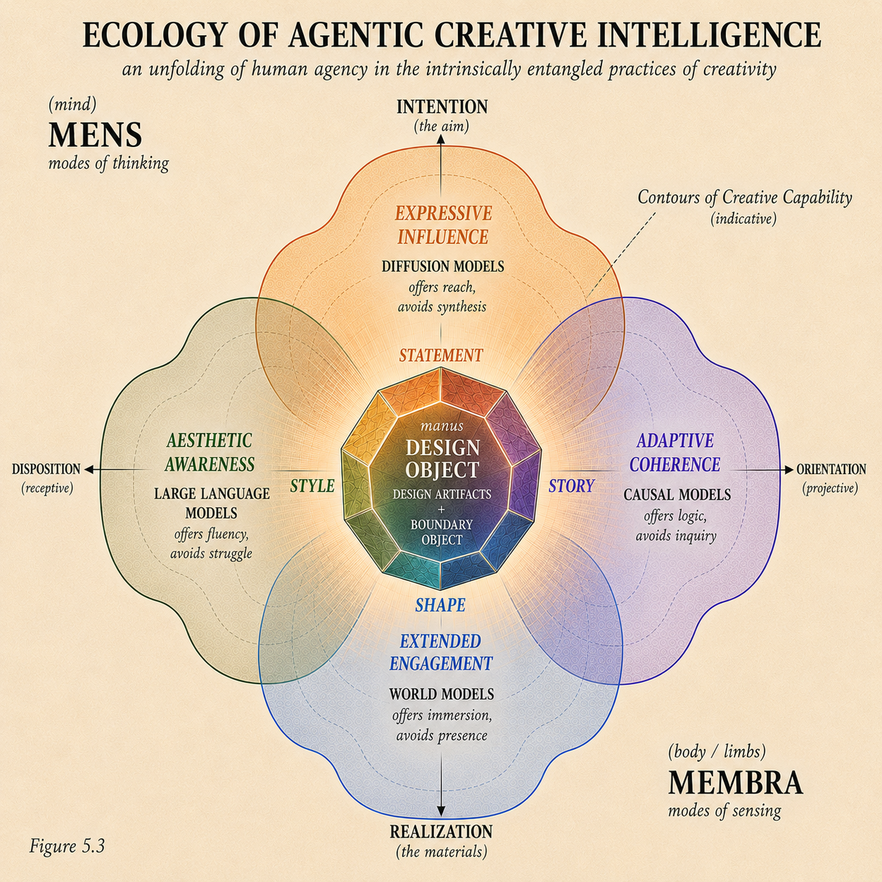
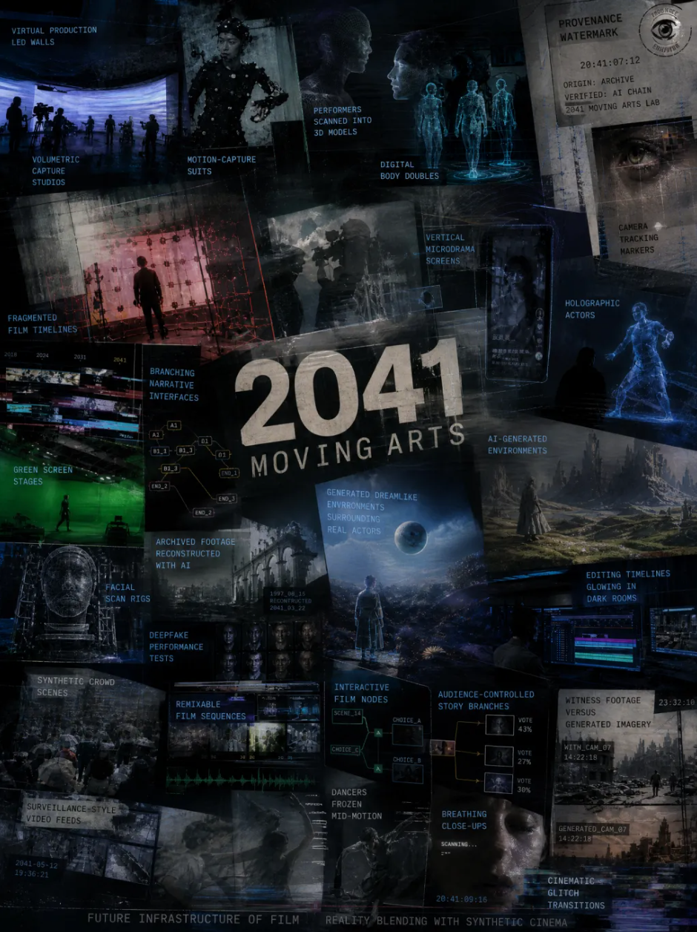
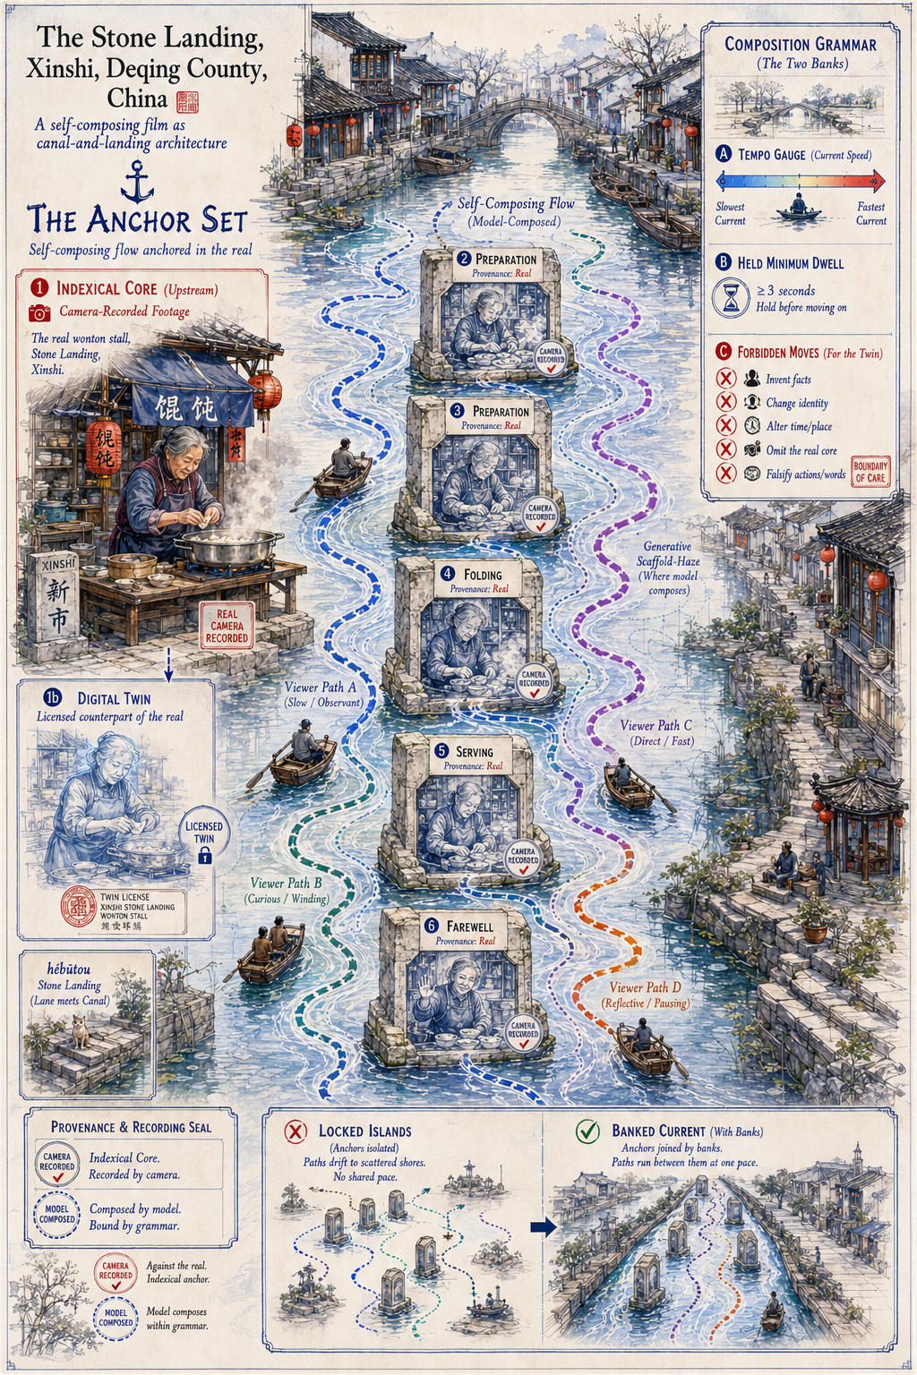
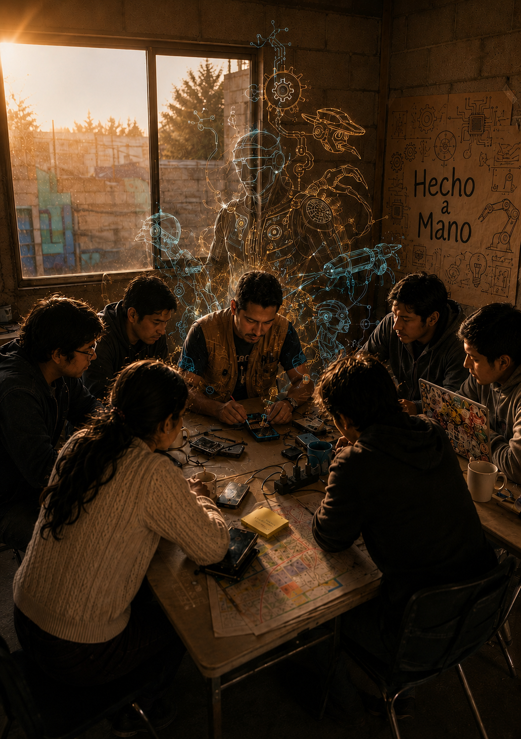
ACI Arc 2. Frameworks and Forecasts into Near Futures
Research / Theoretical graphic framework
Speculative design object
Hybrid
photorealism
Future Forecast
Part I
Part II
Part III

Slide 4


ACI Arc 4. Speculating Discipline + Practice (each Part II chapter)
Future Forecast
Speculative design object
Dæmon
Dæmon
AI Collage
Hybrid
Illustration
Hybrid
Illustration
Hybrid Visualization

Slide 5
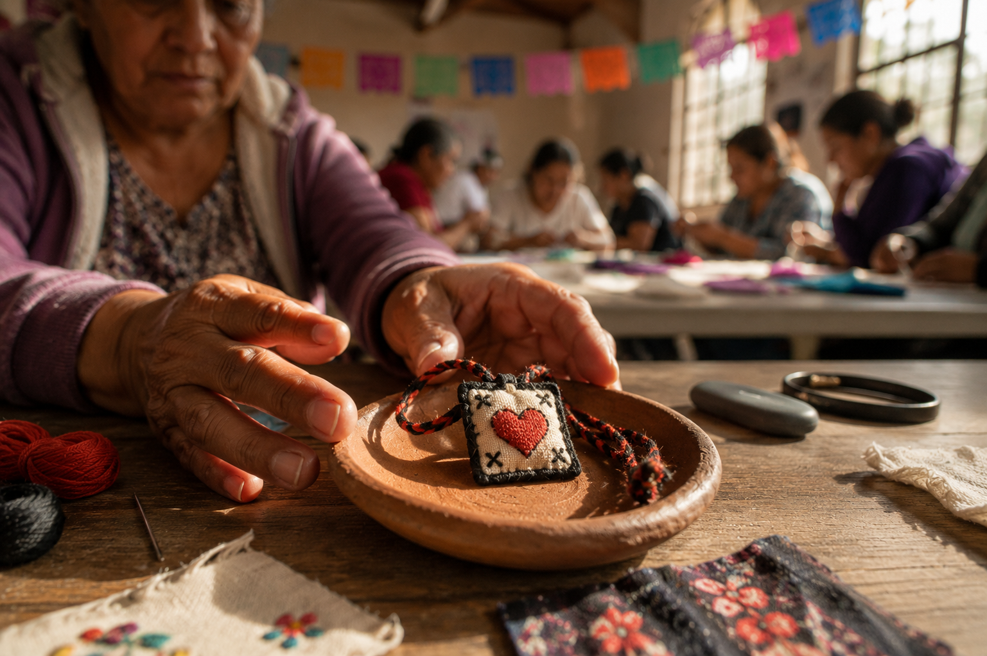
ACI Arc 5. Speculating Systemic Intervention (each Part III chapter)
Framing the intervention
Co-creating the design object
Engagement and Reflection
Hybrid Phototrealism

